Slide 1
UNIT NO – 5 BLOOD RELATIONS
SUBJECT : QUANTITATIVE APTITUDE AND LOGICAL REASONING
DEPARTMENT OF MATHEMATICS SNIST

Slide 2
Blood Relations
Mother’s or Father’s Son--------------------------------------Brother
Mother’s or Father’s daughter------------------------------Sister
Mother’s or Father’s brother------------------------------Uncle
Mother’s or Father’s Sister--------------------------Aunt
Mother’s or Father’s Father-------------------------Grand Father
Mother’s or Father’s Mother-------------------------------------Grand Mother
Grandfather’s or Grandmother’s brother-----------------------Granduncle
Grandfather’s or Grandmother’s sister----------------------------Grandaunt
Son’s wife---------------------------------------------------Daughter-in-law
Daughter’s Husband---------------------------------------Son-in-law

Slide 3
Husband’s or Wife’s sister----------------------------------sister-in-law
Husband’s or Wife’s Brother---------------------------------Brother-in-law
Sister’s/Brother’s son----------------------------------------Nephew
Sister’s/Brother’s daughter--------------------------------Niece
Uncle or Aunt’s son or daughter------------------------cousin
Sister’s husband------------------------------Brother-in-law
Brother’s wife-------------------------sister-in-law
Grandsons or Granddaughter’s/son---------------------Great Granddaughter/G.G.Son
Children of same parents-------------------------------Siblings
Note: A relation on mother’s side is ‘Maternal’ while that on the father’s side is called ‘Paternal’. Thus mother’s bro is ‘maternal uncle’ while father’s brother is ‘paternal uncle’.

Slide 4
Problems:
1) Pointing towards a person, a man said to a woman, “his mother is the only daughter of your father”. How is the woman related to that person?
Sol) The only daughter of woman’s father is she herself. So, the person is woman’s son i.e., mother.
2) Pointing to a lady in the photograph, Shaloo said, “Her Son’s father is the son-in-law of my mother”. How is Shaloo related to the lady?
Sol) Lady’s son’s father is lady’s husband. So, the lady’s husband is the son in law of shallo’s mother i.e., the lady is the daughter of shaloo’s mother. Thus, shaloo is the lady’s sister i.e., Sister.

Slide 5
3) Anil introduced Rohit as the son of the only brother of his father’s wife. How is Rohit related to Anil?
Sol) The relations may be analyzed as follows:
Father’s wife --------------- mother;
Mother’s brother ------------------ uncle;
Uncle’s son ------------------- cousin.
So, Rohit is Anil’s cousin.
4) Pointing toward a person in the photograph, Anjali said, “He is the only son of the father of my sister’s brother”. How is that person related to Anjali?
Sol) sister’s brother- brother; brother’s father – father;
Father’s son – brother.

Slide 6
5) Rita told Mani, “The girl I met yesterday at the beach was the youngest daughter of the brother-in-law of my friend’s mother”. How is the girl related to Rita’s friend?
Sol) Daughter of brother in law – niece;
Mother’s niece- cousin.
So, the girl is the cousin of Rita’s friend.
6) If X is the brother of the son of Y’s son, how is X related to Y?
Sol) Son of Y’s son – Grand son; Brother of Y’s grandson – Y’s grand son i.e., grand son.

Slide 7
7) Pointing to Kapil, Shilpa said, “His mother’s brother is the father of my son Ashish”. How is Kapli related to Shilpa?
Sol) Father of shilpa’s son-Shilpa’s husband.
So, kapli is the son of sister of shilpa’s husband. Thus, kapil is shilpa’s nephew i.e., nephew.
8) Pointing to a photograph, a lady tells Pramod, “I am the only daughter of this lady and her son is your maternal uncle”. How is the speaker related to Pramod’s father?
Sol) Clearly, the speaker’s brother is pramod’s maternal uncle. So, the speaker is pramod’s mother or his father’s wife. i.e., wife.

Slide 8
Relation Puzzle
In the type of questions, mutual blood relation of more than two persons are mentioned.
1) A family has a man, his wife, their four sons & their wife. The family of every son also has 3 sons and one daughter. Find the out the total number of male members in the whole family?
Sol) 17
2) A & B are brothers. C & D are sisters. A’s son is D’s brother. How is B related to C?
Sol) A’s son is D’s brother --------------------- D is d/o of A
C and D are sisters ----------------------- C also d/o A
A & B are brothers ------------------------- B is uncle of C.
3) A is B’s sister. C is B’s mother, D is C’s father, E is D’s mother. Then, how is A related to D?
Sol) A is the sister of B and B is the son/daughter of C. so, A is daughter of C. Also, D is the father of C. Thus, A is the granddaughter od D. i.e., Granddaughter.

Slide 9
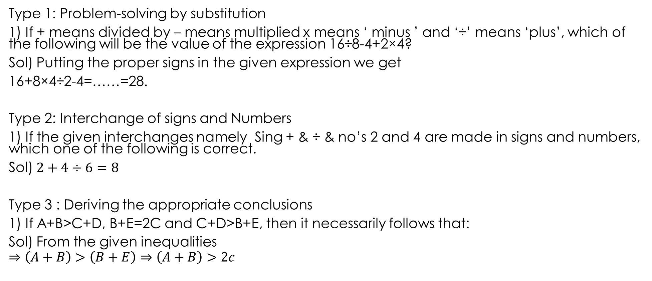
Mathematical Operations
Type 1: Problem-solving by substitution
1) If + means divided by – means multiplied x means ‘ minus ’ and ‘÷’ means ‘plus’, which of the following will be the value of the expression 16÷8-4+2×4?
Sol) Putting the proper signs in the given expression we get
16+8×4÷2-4=……=28.
Type 2: Interchange of signs and Numbers
1) If the given interchanges namely Sing + & ÷ & no’s 2 and 4 are made in signs and numbers, which one of the following is correct.
Sol) $2+4÷6=8$
Type 3 : Deriving the appropriate conclusions
1) If A+B>C+D, B+E=2C and C+D>B+E, then it necessarily follows that:
Sol) From the given inequalities
$$⇒\left(A+B\right)>\left(B+E\right)⇒\left(A+B\right)>2c$$

Slide 12
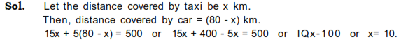
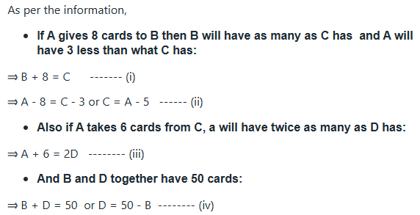
2.A worker may claim Rs 15 for each km which he travels by taxi and Rs 5 for each km which he drives his own car. If in one week he claimed Rs 500 for travelling 80 km how many kms did he travel by taxi ?
3.A, B, C and D play a game of cards. A says to B, uIf I give you 8 cards, you will have as many as C has and I shall have 3 less than what C has. Also, if I take 6 cards from C, I shall have twice as many as D has." If B and D together have 50 cards, how many cards has A got ?
Solving these equations A=40

Slide 13
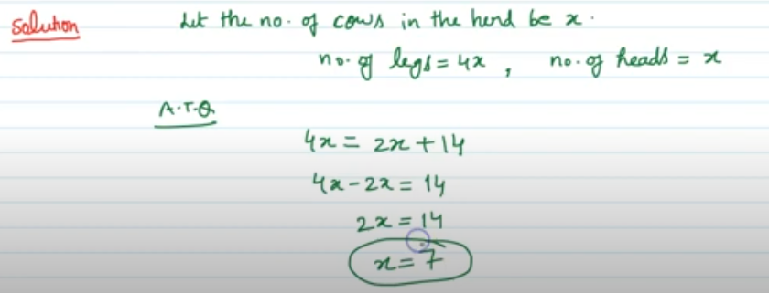

Slide 14
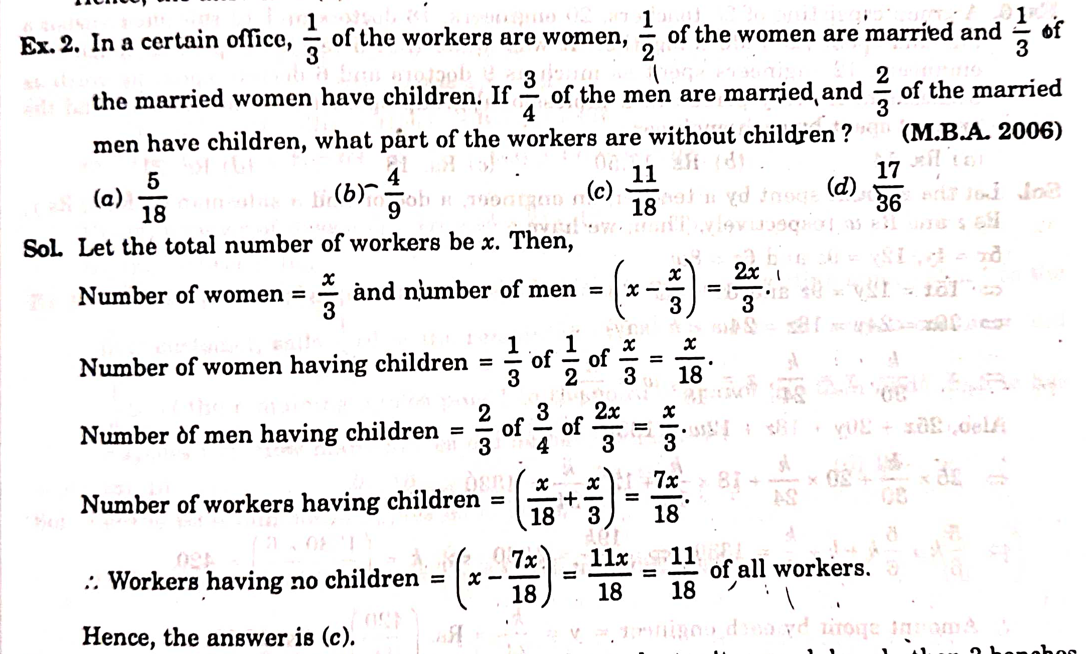

Slide 16
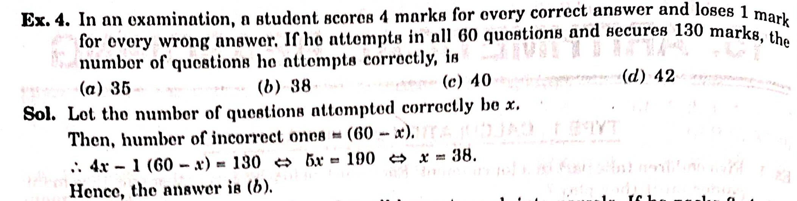

Slide 19
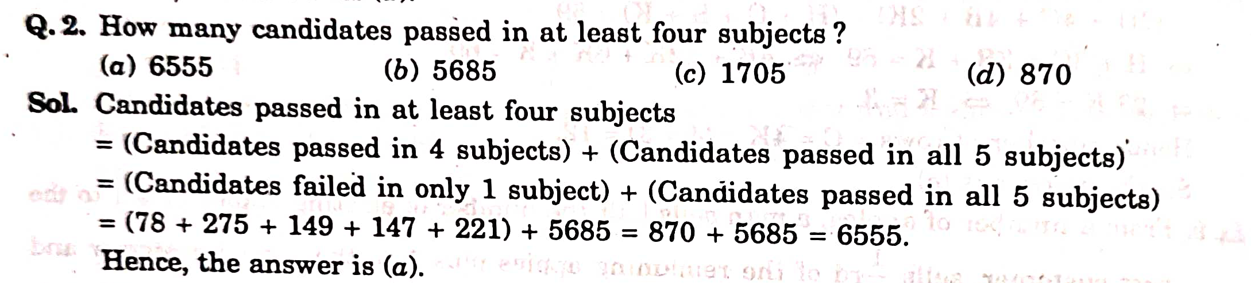

Slide 20
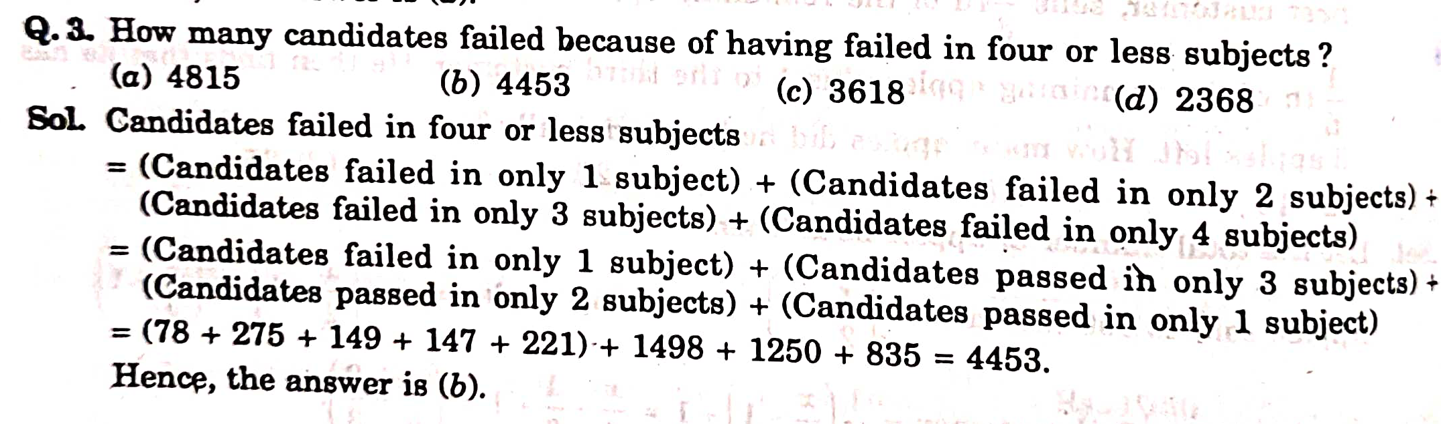

Slide 23
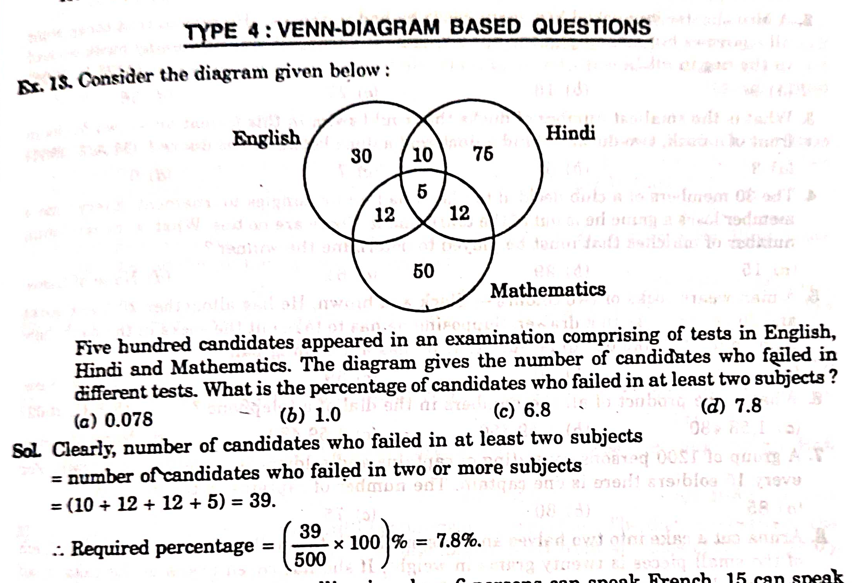

Slide 24
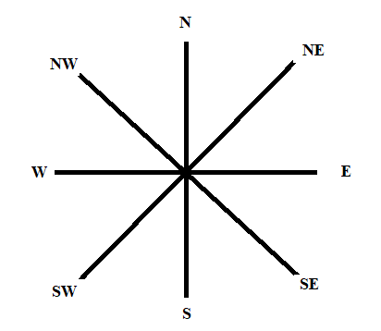
Direction Sense Test
Main Direction: N,E,W, S
Cardinal Directions: NE, NW, SE, SW

Slide 25
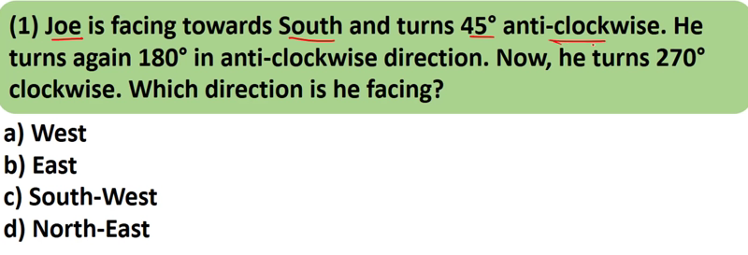
Option:C

Slide 26
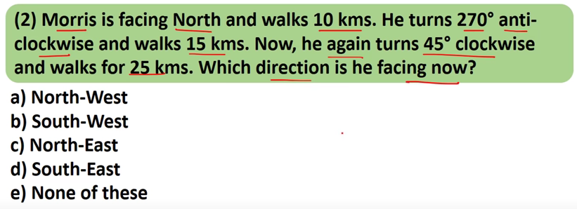
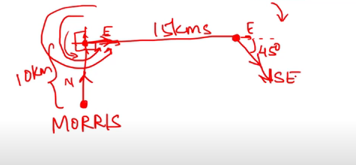

Slide 27
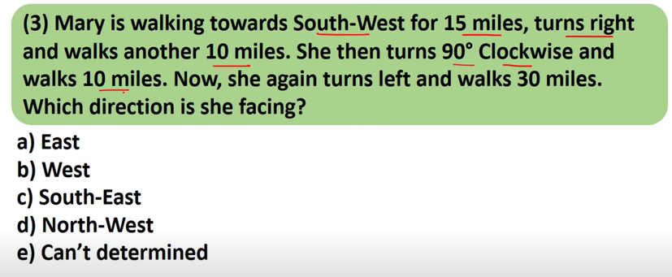
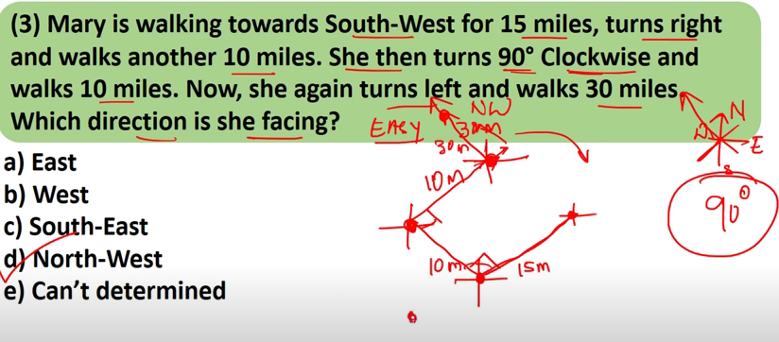

Slide 28
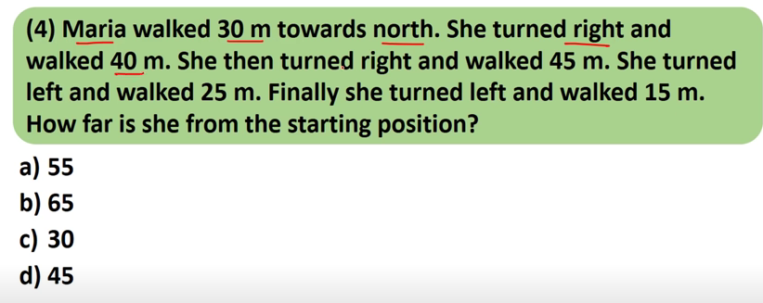
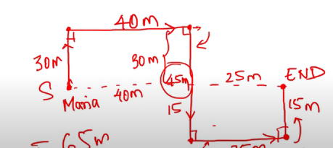

Slide 29
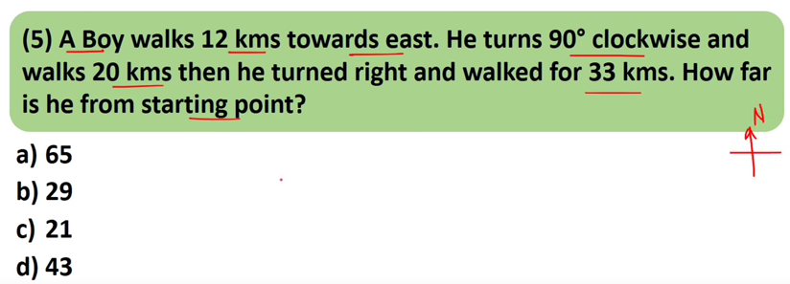
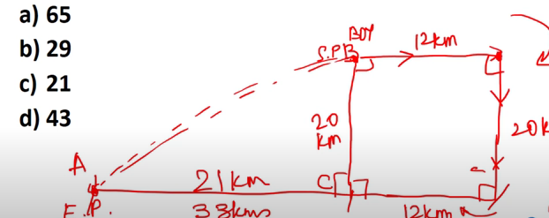
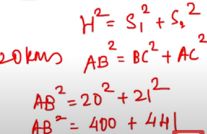

Slide 31
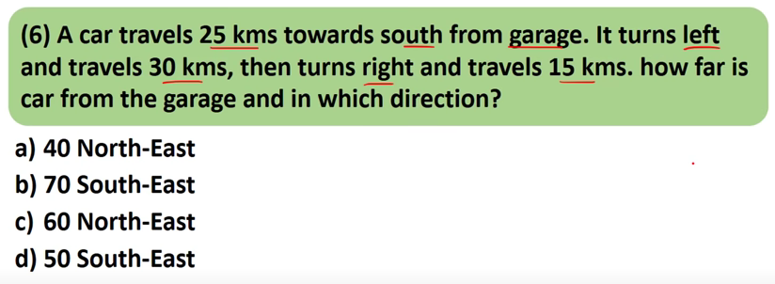
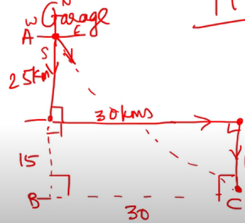
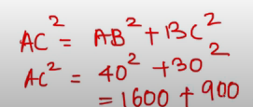

Slide 32
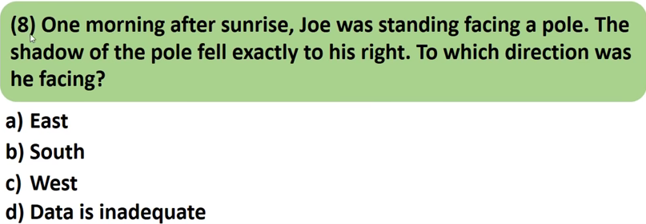
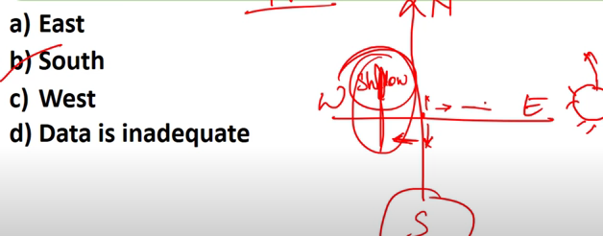

Slide 33
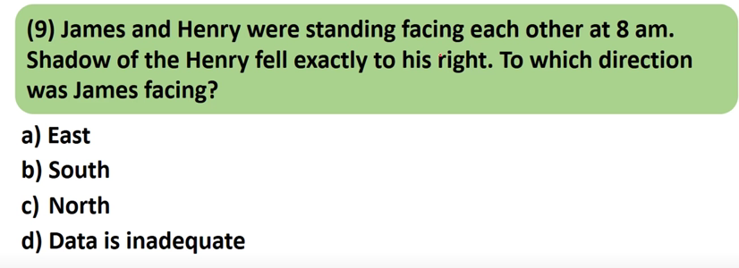
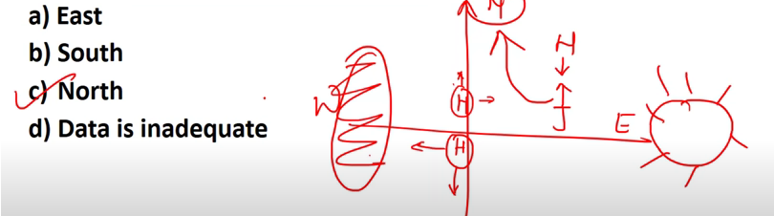

Slide 34
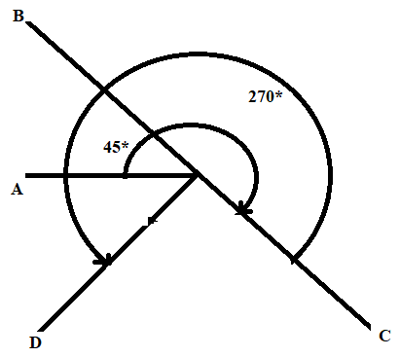
PROBLEMS
1) A Man is facing west. He turns 45* in the clock wise direction & then another 180* in the same direction and then 270* in the anti-clock wise direction which direction is he facing now?
Sol) Clearly, the man initially faces in the direction OA. On moving 45* clockwise, he faces in the direction OB. On further moving 180* clock wise, he faces in the direction OC. Finally, on moving 270* anti-clockwise, he faces in the direction OD, which is south-west.

Slide 35
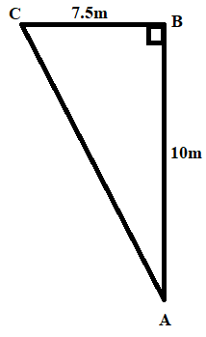
2) If you are facing north-east and move 10m forward, turns left and move 7.5m, then you are?
Sol) Clearly, the narrator starts from A, moves towards north east a distance of 10m up to B, turns left (90* anti clock wise) and moves 7.5m up to C. clearly, C lies to the north of A. also triangle ABC is right angled at B.
⇒ AC = 12.5m i.e., 12.5m to the north of initial position.

Slide 36
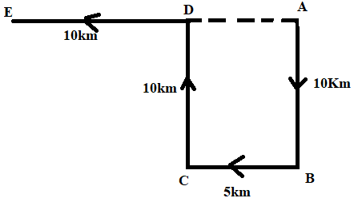
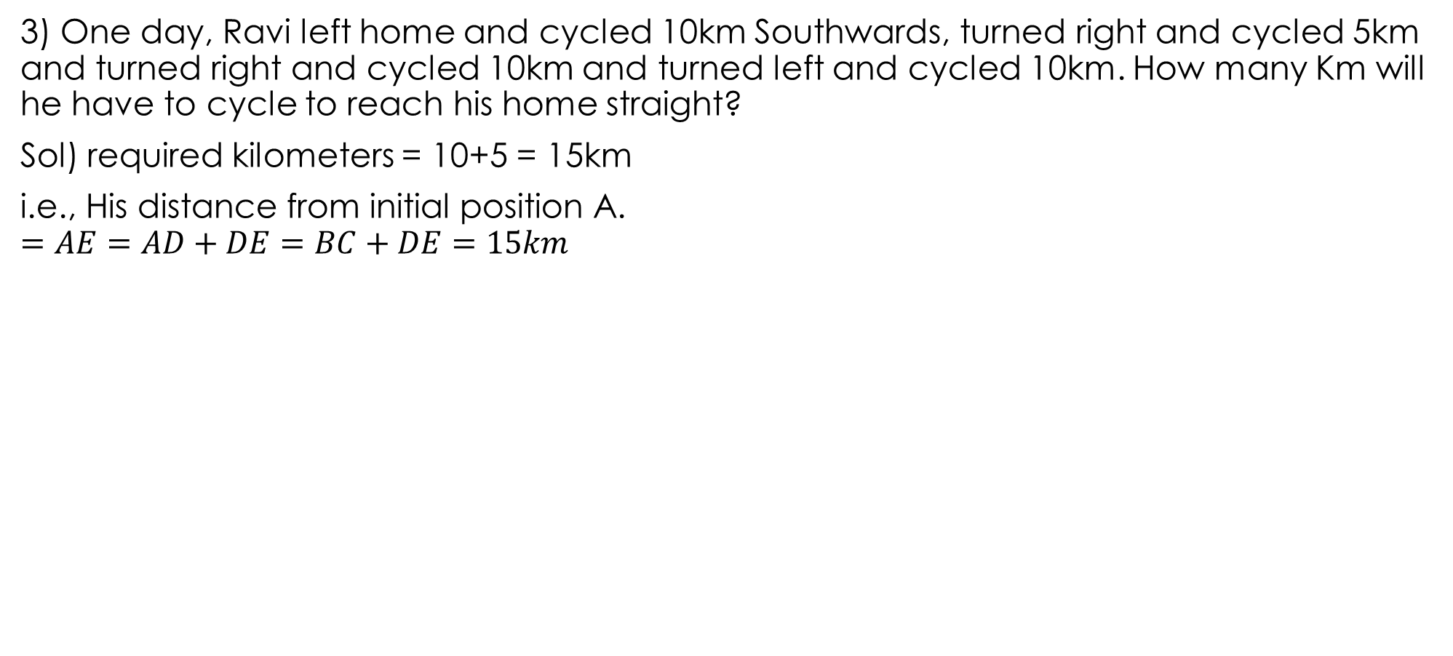
3) One day, Ravi left home and cycled 10km Southwards, turned right and cycled 5km and turned right and cycled 10km and turned left and cycled 10km. How many Km will he have to cycle to reach his home straight?
Sol) required kilometers = 10+5 = 15km
i.e., His distance from initial position A.
$$=AE=AD+DE=BC+DE=15km$$

Slide 37
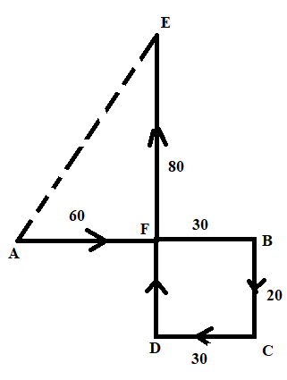
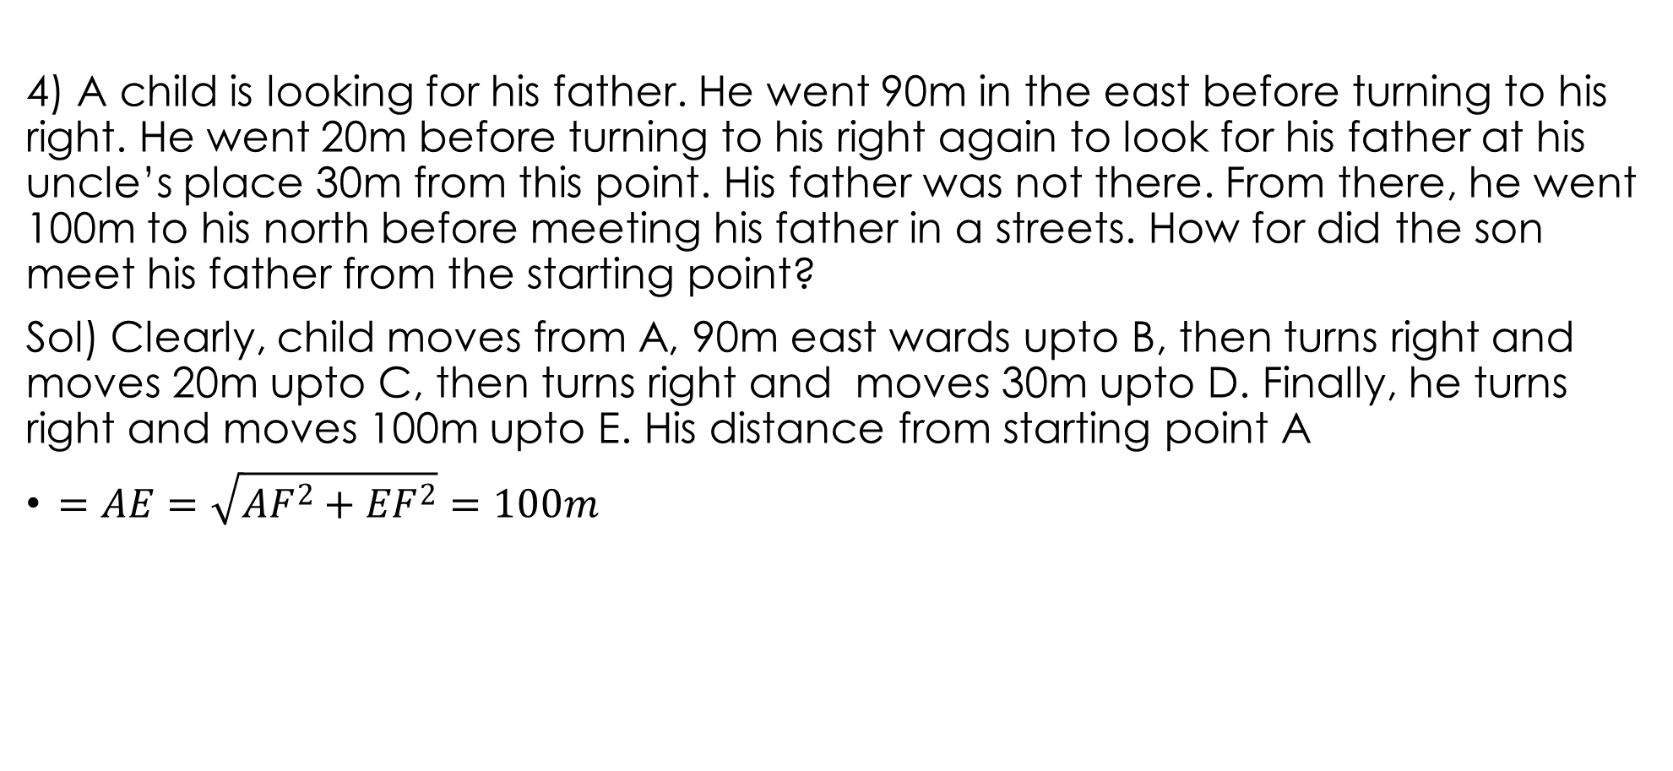
4) A child is looking for his father. He went 90m in the east before turning to his right. He went 20m before turning to his right again to look for his father at his uncle’s place 30m from this point. His father was not there. From there, he went 100m to his north before meeting his father in a streets. How for did the son meet his father from the starting point?
Sol) Clearly, child moves from A, 90m east wards upto B, then turns right and moves 20m upto C, then turns right and moves 30m upto D. Finally, he turns right and moves 100m upto E. His distance from starting point A
$=AE=\sqrt{{AF}^{2}+{EF}^{2}}=100m$

Slide 38
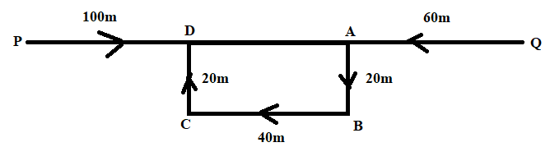
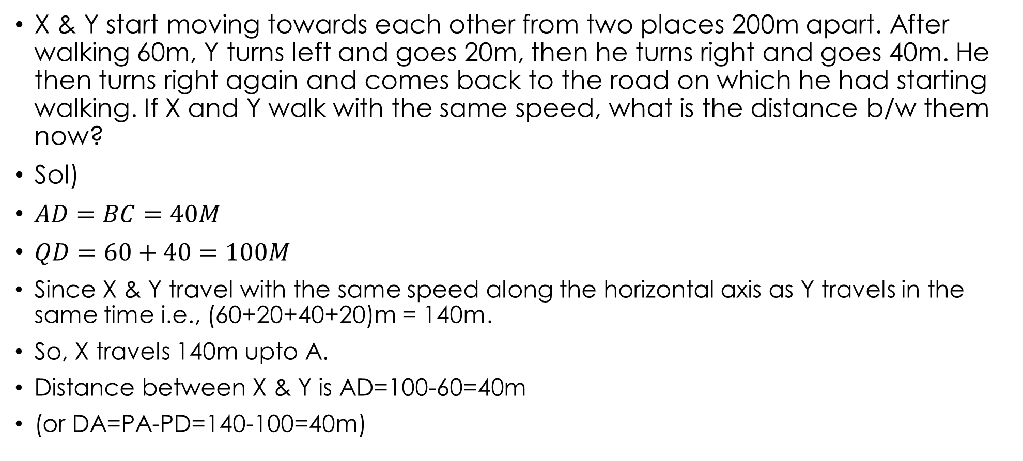
X & Y start moving towards each other from two places 200m apart. After walking 60m, Y turns left and goes 20m, then he turns right and goes 40m. He then turns right again and comes back to the road on which he had starting walking. If X and Y walk with the same speed, what is the distance b/w them now?
Sol)
$AD=BC=40M$
$QD=60+40=100M$
Since X & Y travel with the same speed along the horizontal axis as Y travels in the same time i.e., (60+20+40+20)m = 140m.
So, X travels 140m upto A.
Distance between X & Y is AD=100-60=40m
(or DA=PA-PD=140-100=40m)

Slide 39
Number, Ranking and Time Sequence Test:
Type 1: Number Test:
In this type of questions, generally a set, group or series of numerals is given and the candidate is asked to trace out numerals following certain given condition or lying at specific mentioned positions after shuffling according to a certain given pattern.

Slide 40
Problems:
1) How many such 5’s are there in the following number sequence each of which is immediately preceded by 3 or 4 but not immediately followed by 8 or 9?
3 5 9 5 4 5 5 3 5 8 4 5 6 7 3 5 7 5 5 4 5 2 3 5 10
Sol) As you know a number which comes after a given number is said to follow it while the one which comes before the given number precedes it. i.e., 5 .3 5 9 5 4 5 5 3 5 8 4 5 6 7 3 5 7 5 5 4 5 2 3 5 10.
2) In the series given below, how many 8’s are there each of which is exactly divisible by its immediate preceding as well as succeeding numbers?
2 8 3 8 2 4 8 2 4 8 6 8 2 8 2 4 8 3 8 2 8 6
Sol) 2. since 2 8 3 8 2 4 8 2 4 8 6 8 2 8 2 4 8 3 8 2 8 6

Slide 41
3) The positions of the 1st and the 2nd digits in the number 94316875 are interchanged. Similarly, the positions of the 3rd & 4th digits are inter changed and so on. Which of the following will be the 3rd to the left of the 7th digit from the left end after the re-arrangement?
Sol) Changing the positions of the digits as mentioned , we get the no 49138657. The 7th digit from the left end of this number is 5. The 3rd digit to the left of 5 is 3.
4) 36 vehicles are parked in a parking lot in a single row. After the first car, there is one scooter. After the 2nd car, there are 2 scooters. After the 3rd car there are 3 scooters and so on. Workout the number of scooters in the 2nd half of the row?
Sol) let C & S denote car & Scooter. Then,
C S C S S C S S S C S S S S C S S S
S S C S S S S S S C S S S S S S S C i.e., 15.

Slide 42
Type 2: Ranking Test:
Problems:
1) Rohan ranks 7th from the top & 26th from the bottom in a class. How many students are there in a class?
31
32
33
34
Sol) clearly the whole class consists of 6 students who have ranks higher than Rohan;
25 students who have ranks lower than rohan. i.e., (25+1+6)=32 students.
NOTE: Total=Left+Right-1

Slide 43
2) Manik is 14th from the right end in a row of 40 boys. What is his position form the left end?
24th
25th
26th
27th
None of these
Sol) clearly no. of boys towards the left of manik = 40-14 = 26
So manik is 27th from the left end.
3) In a row of boys facing the North, A is 16th from the left end and C is 16th from the right end. B, who is 4th to the right of A, is 5th to the left of C in the row. How many boys are there in the row?
39
40
41
42
None of these
Sol) clearly according to the given conditions, there are 15 boys to the left of A, as well as to the right of C. Also, B lies between A & C such that there are 3 boys between A & B; and 4 boys between B & C.
So, the number of boys in the row = 15+1+3+4+1+1+15 = 40

Slide 44
Type 3: Time sequence Test
1) Satish remembers that his brother’s birthday is after 15th but before 18th of February where as his sister Kajal remembers that her brother’s birthday is after 16th but before19th of February. On which day in February is Satish’s brother’s birthday
16th
17th
18th
19th
None of these
Sol) According to sathish the brothers birthday is on one of the days among 16th & 17th February.
According to Kajal, the brother’s birthday is o one of the days among 17th & 18th February.
Clearly, sathish’s brother’s birthday is on the day common to both the groups, i.e., 17th February.

Slide 45
2) A bus for Delhi leaves every 30 minutes from a bus stand. An enquiry clerk told a passenger that the bus had already left ten minutes ago and the next bus will leaves at 9:35am. At what time did the enquiry clerk give this information to the passenger?
9:10 am
8:55am
9:08am
9:05am
9:15am
Sol) The next bus will leave at 9:35am. This means that the previous bus had left at 9:05am. But it happened 10minutes before the clerk gave the information to the passenger. Thus, the enquiry clerk gave the information at 9:15am.
3) If the 7th day of a month is 3 days earlier than Friday. What day will it be on the 19th day of the month?
Sunday
Monday
Wednesday
Friday
Sol) As mentioned the 7th day of the month is 3 days earlier than Friday, which is Tuesday. So, the 14th day is also Tuesday. Thus, the 19th day is Sunday.

Slide 46
4) If it was Saturday on 17th December 2002. What was the day on 22nd December 2004?
Monday
Tuesday
Wednesday
Sunday
Sol) Clearly every day repeats itself on the 7th day. Now, 17th Dec, 2002- 16th dec, 2003 is a period of 365 days. Dividing by 7, we get 52 weeks and one day. Thus, the 365th day will be the same as the 1st day i.e., 16th dec, 2003 is also Saturday. Now 16th dec, 2003 – 15th dec, 2004 is a period of 366 days (because 2004 being a leap year, has 29 days in February). Thus as shown above, 14th dec, 2004 will be the same as 16th dec, 2003, i.e., Saturday. So, 21st dec, 2004 is also Saturday and thus 22nd dec, 2004 is a Sunday.
NOTE: Observations:
A year has 365 days.
Years, divisible by 4, are leap years; eg: 1980, 1984, 1988,…, 2004, 2008,…, they have 366 days.
February in a leap year has 29 days.
The last day of a year is the same as 1st day.

Slide 47
PUZZLE TEST
Type 1: Classification Type Questions
This type consists of question in which certain items belonging to different groups or processing different qualities are given along with some clues with the help of which the candidate is required to group and analyze the given items and answer the question accordingly.

Slide 48
Problems
1) Study the following information carefully and answer the given questions:
B & E are good in Dramatics & Computer Science.
A & B are good in Computer science & Physics
A, D & C are good in Physics & History
C & A are good in Physics & Mathematics
D & E are good in History & Dramatics
Who is good in Physics, History & Dramatics?
Who is good in Physics, History & Mathematics, but not in computer science?
Who is good in computer science, History & Dramatics?
Who is good in History, Physics, Computer Science & Math’s?
Who is good in Physics, Dramatics & Computer Science?

Slide 49
1) D, 2) A and C, 3) E, 4) A, 5)B
 | DRAMATICS | COMPUTER SCIENCE | PHYSICS | HISTORY | MATHEMATICS
A | N | Y | Y | Y | Y
B | Y | Y | Y | N | N
C | N | N | Y | Y | Y
D | Y | N | Y | Y | N
E | Y | Y | N | Y | N

Slide 50
2) A,B,C,D, E, F & G are travelling in 3 different vehicles. There are at least 2 passengers in each vehicle 1,2 & 3 and each vehicle has passengers of both the genders. There are 2 engineers, 2 doctors and 3 teachers among them. C is a lady doctor and she does not travel with the pair of Sisters A & F. B, a male engineer, travels with only G, a Teacher in vehicle 1. D is a male doctor. 2 persons belonging to the same profession do not travel in the same vehicle. A is not an engineer and travels in vehicle 2
In which vehicle does C travel?
How many lady members are there among them?
What is F’s profession?
Which of the following is not correct?
A- Female- Teacher
B- male- Engineer
E- Male- Teacher
F- Female- Teacher
G- Female – Teacher
Which of the following represents the 3 teachers?

Slide 51
Sol)
B, a male engineer travels with only G, a teacher in vehicle 1. Since each vehicle has persons of both the genders, so G is a female. C does not travel with A or F. Also, no person travels with any person of the same profession. Since C & D are both doctors, so C does not travel with D. Since A travels in vehicle 2, so C travels with E in vehicle 3. Since C is a female, so E is a male.
Thus A, D & F travels in vehicle 2. So, their professions must be different. D is a doctor. Since A is not an engineer being sisters, are both females. B & F are 2 engineers, C & D are two doctors. So, A, E & G are all teachers.

Slide 52
C travels in 3 [or 1: A=2, B=1 C= 1 D= 2 E=3 F=3 G=1]
A,C,F & G
F- Engineer
F-Female- Teacher
A,E,G- Teacher.
PERSON | A | B | C | D | E | F | G
VEHICLE | 2 | 1 | 3 | 2 | 3 | 2 | 1
PROFESSION | TEACHER | ENGINEER | DOCTOR | DOCTOR | REACHER | ENGINEER | TEACHER
Gender | FEMALE | MALE | FEMALE | MALE | MALE | FEMALE | FEMALE

Slide 53
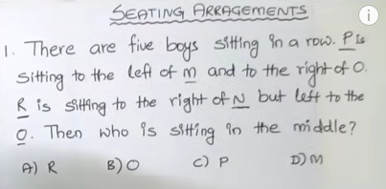
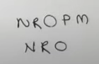
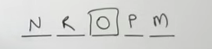
Type 2 : SEATING PLAN/PLACING ARRANGEMENTS

Slide 54
1) 9 cricket fans are watching a match in a stadium. Seated in one row, they are J,K,L,M,N,O,P,Q & R. L is at the right of M & at 3rd place at the right of N. K is at one end of the row. Q is seated adjacent to both O & P. O is at the 3rd place at the left of K. J is immediately next to left of O.
Who is sitting at the center of the row?
Who is at the other end of the row?
Which of the following statements is true?
N is 2 seats away from J
M is at one extreme end
R & P are neighbors
There is one person between L & O

Slide 55
Sol)
N_ML
_ _ _ _ K
O Q P
O Q P K
J O Q P K
Left over : R
NRMLJOQPK
J
N
(IV)

Slide 56
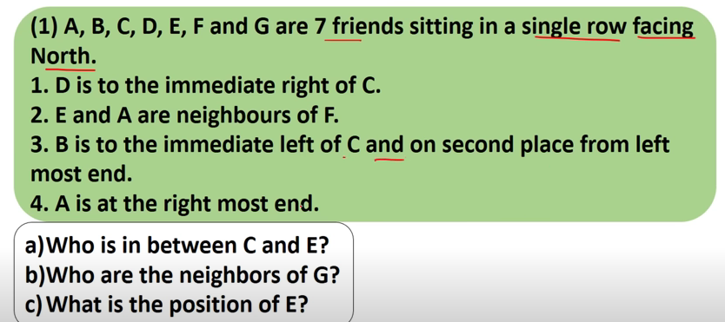



Slide 57
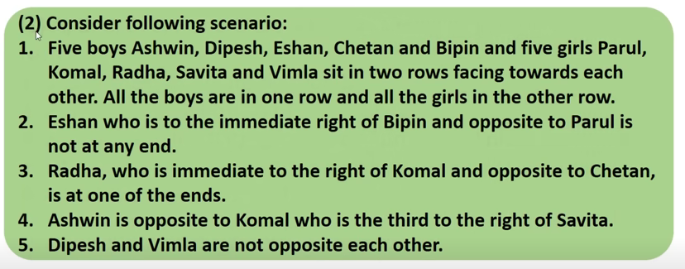
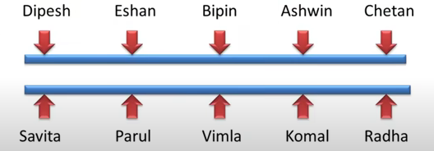
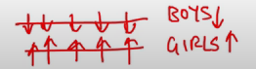



Slide 58
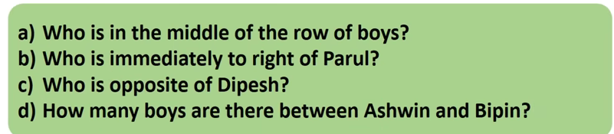
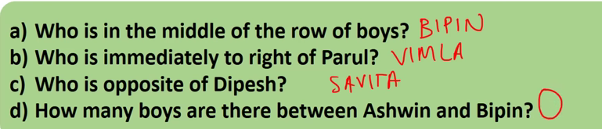

Slide 59
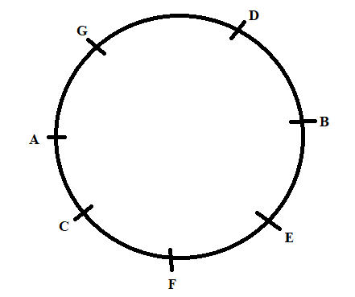
Circular Arrangements
A,B,C,D,E,F & G are sitting around a circle and are facing center
G is second to the left of C, who is to the immediate left to F
A is 3rd to the left of E
B is between D & E

Slide 60
1) Which of the following is false?
A is 4th to the right of E
G is to the immediate right of D
F is 3rd to the right of D
B is to the immediate left of D
None of these
Sol) C
2) Which of the following is true?
C is 4th to the left of B
A is to the immediate right of G
D is 2nd to the left of E
B is 2nd to the right of G
Sol) B

Slide 61
3) Which of the following pairs has the 1st person sitting to the immediate left of the 2nd person?
BE
CA
GD
DG
None
Sol) D
4) Which of the following has the middle person sitting between the remaining two?
FCE
EFB
DEB
GDA
None
Sol) E

Slide 62
5) Which of the following is the position of F?
4th to the right of D
To the immediate left of C
Between A & E
TO the immediate right of A
None
Sol) A
Note:
Left- Clock wise
Right- Anti Clock wise
Left/Right- Immediate Left/ Immediate Right

Slide 63
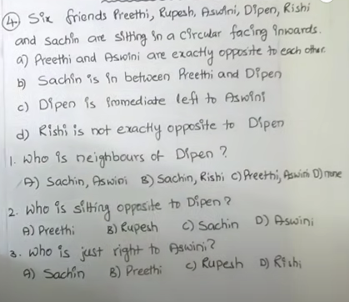

Slide 64
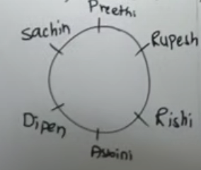
1.A 2.B 3.D

Slide 65
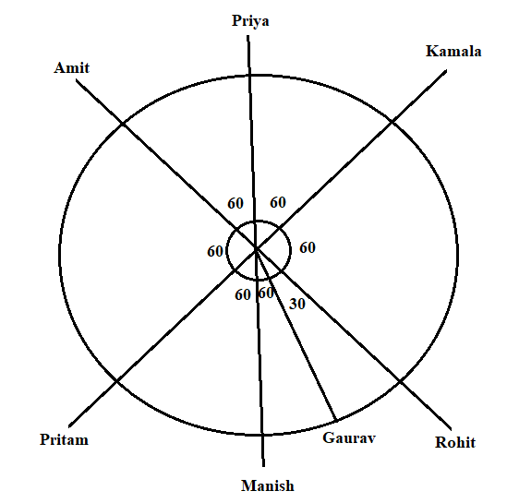
2) 7 friends Kamala, Manish, Rohit, Amit, Gaurav, Pritham & Priya are sitting in a round table. Except Gaurav all are sitting at equal distance from each other. Rohit is sitting 2 places tight of Pritham, who is sitting one place right of Amit. Kamala forms an angle of 90 degrees from Gaurav and an angle of 120 degrees from Manish. Manish is just opposite Priya & is sitting on the left of Gaurav?

Slide 66
Who is the only person sitting between Rohit & manish?
Sol) Gaurav
Gaurav is not sitting at equal distance from
Rohit & Pritam
Amit & Kamala
Manish & Pritam
All the above
Sol) D

Slide 67
Gaurav is sitting ________ of Priya
To the left
To the right
2 places right
None of these
Sol) 4
The angle between Gaurav and Manish is the clockwise direction?
Sol) 30 degrees
Which of the following statements is not correct?
Pritam is between Manish & Kamala
Manish is 2 places away from Priya
Gaurav is sitting opposite Pritam
All the above
Sol) D

Slide 68
COMPARISION
A is older than M. G is older than M but younger than A. K is younger than R & M. M is older than R?
a) Whose age is between G & R?
Sol) M
b)Whose age is between M & K?
Sol) R
c) Whose age is exactly in the middle of all the five?
Sol) M
d) Who is the eldest?
Sol) A
e) Who is the youngest? K
Sol) A > M, G > M, A > G ⇒ A > G > M---------- 1
R > K, M > K, M > R ⇒ M > R > K------------ 2
From 1 & 2 ⇒ A > G > M > R > K

Slide 69
Sequential Order of Things
1) 6 firms – P, Q, R, S, T & U are to be released on consecutive Fridays. The Schedule of the release is to be in accordance with the following conditions:
P must be released a week before T
R must not be released immediately after the first release
Q must be released on the Friday on which U is released
S must be released on 5th Friday and should not be immediately preceded by Q
T must not be released in the last?
Which of the following films preceded T?
Sol) P
Which of the following films released immediately after Q?
Sol) P

Slide 70
Film R cannot be released on which of the following Fridays in addition to 2nd Friday?
Sol) 5th because S has to be staged on that day.
In between which of the two films S is to be released?
Sol) R & T
Which of the following films released first ?
Sol) U

Slide 71
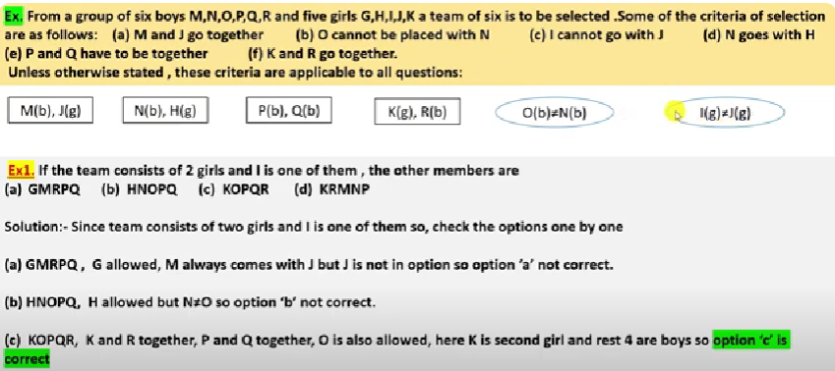
Selection Based on given Conditions

Slide 72
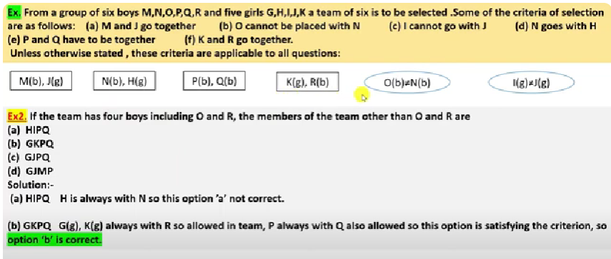

Slide 73


Slide 74


Slide 75


Slide 76

Family Based puzzles

Slide 77


Slide 78

Read the following information carefully and answer the questions below it

Slide 79


Slide 80

Read the following information carefully and answer the questions below it

Slide 81



Slide 82


Slide 83
JUMBLED PROBLEMS
In this type of questions, some mixed clues regarding three or more qualities of given items or persons is given. The candidate is required to analyse this mixed information with respect to different qualities and classify the items accordingly.

Slide 84
Ex. Read the following statements and answer the questions that follow :
Of the six men of literature A, B, C, D, E and F being considered here, two belonged to the 17th century,three to the 19th and one to the 20th century. Four were recognized as great poets, three as great novelists and three as great dramatists. One contributed to Bengali literature, two to Hindi, two to Marathi and one to Tamil. The 20th century writer wrote poetry only and contributed to Marathi literature and the other Marathi writer contributed to poetry, novel and drama. One Hindi writer and the only Tamil writer belonged to the 19th century- The former contributed to poetry and novel while the latter to novel and drama. The Bengali writer belonged to the 17th century and contributed to poetry only. A belonged to the 20th century’. B wrote drama only, C contributed to Marathi literature, D was a Hindi poet and novelist and belonged to the 19th century. E also belonged to the 19th century, and F contributed to poetry only.

Slide 85
To which language did B contribute ?
(a) Bengali b) Hindi (c) Marathi (d) Tamil
2. Among these, who was the Tamil writer ?
a) A (6) B c) E d) F
3. To which branch of literature did A contribute ?
a) Poetry (b) Novel c) Drama d) All of these
4. Among these, who was the Bengali writer ?
A (d) B c) E d) F.
4To which branch of literature did C contribute ?
a) Poetry b) Drama c) Novel d) All the three

Slide 86
Solution : Clearly, there is one belonging to 20th century. So, A who belongs to 20th century contributes to Marathi poetry. Also, D is a Hindi poet and novelist who belongs to the 19th century. There are only two Marathis. So, C who is a Marathi will contribute to poetry, novel and drama. Clearly, there are only four poets. So, F who is a poet, will be Bengali belonging to the 17th century. There is now no other Bengali, no other Marathi and no other poet B, who wrote drama only cannot be Tamil and does not belong to 19th century. So, B belongs to 17th century and is a Hindi dramatist. Thus, E belonging to the 19th century is a Tamil novelist and dramatist. C will belong to the 19th century.
(b): B contributes to Hindi.
2. (c): E is the Tamil writer
3. (a): A contributes to poetry alone.
4. (d): F is the Bengali writer.
5. (d) : C contributes to all the three — poetry, novel and drama.

Slide 87
Thank You

